Slide 1
EENG 385 Amplifier Theory
Notes:
Usually the <title of the lab> is what will be called the “System” through the rest of this document

Slide 2
Lab Objectives
The objective of this lab is to analyze the operation and electrical characteristics of the audio amplifier stage of the Audio board and to prepare you to solder together the audio amplifier subsystem of the Audio board.

Slide 3
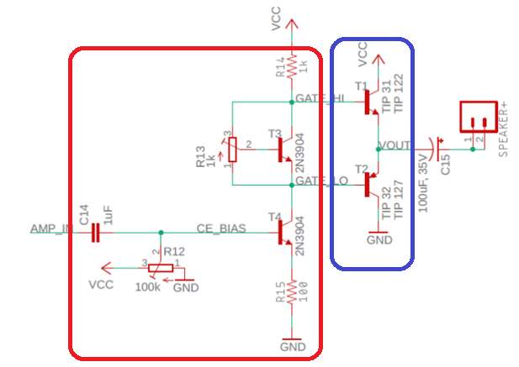
Theory
Two stage
Input from audio source via 3.5mm jack
Common emitter, voltage amplifier
Emitter follower, current amplifier
Notes:
Replace <System> with the name of the

Slide 4
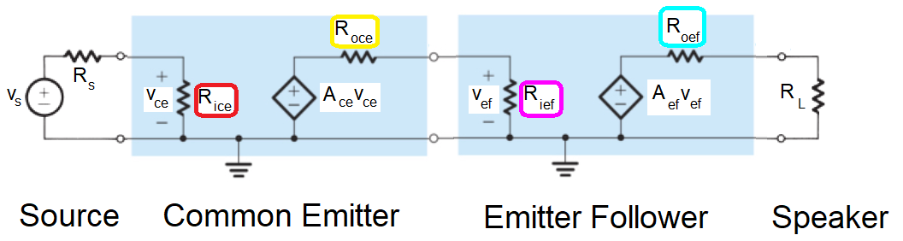
Theory
Model circuit with small signal model
Vs is audio source, your MP3 player
Use analysis to determine values in colored boxes
Notes:
Replace <System> with the name of the

Slide 5
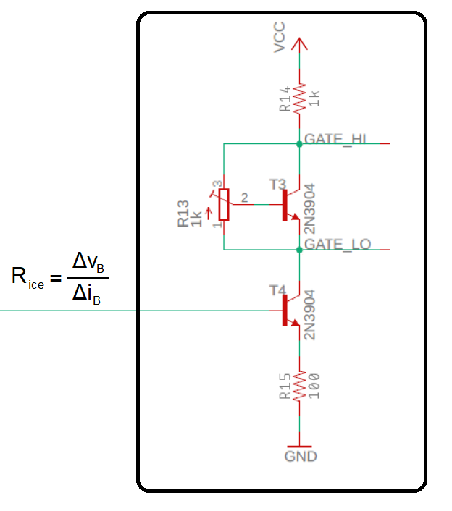
Small Signal Input Resistance
Small signal input resistance
Looks at changes in voltage/current
Example: Find R_{ice}
V = I*R so R_{ice} = Δv_{B} / Δi_{B}
Effect of Δv_{B} on Δv_{E} at T4?
Effect of Δi_{E} on Δv_{E} at T4?
Relationship between Δi_{B} on Δi_{E}

Slide 6
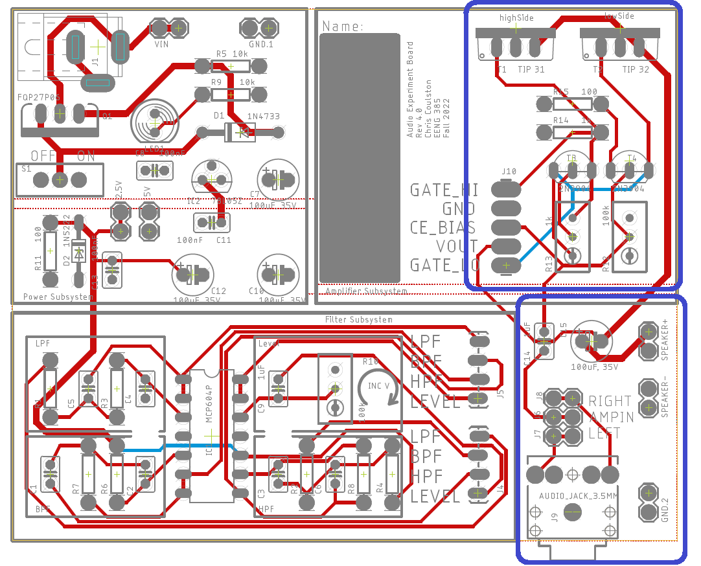
Assemble
Audio input & amplifier
Polarized parts
100uF
TIP 31 or122 NPN
TIP 32 or 127 PNP
2N3904
1k and 100k Pot
Notes:
Replace <System> with the name of the

Slide 7
Test
No testing of assembled circuit
If POTs are not adjusted, it may look like your circuit has a short circuit
Wait until next week’s lab to power up.
Notes:
Replace <System> with the name of the

Slide 8
Turn In
Audio Amplifier Steps 1 – 3
Common Emitter Theory Steps 1 – 3
The Vbe Multiplier Steps 1 – 12
Rice Steps 1 – 6
Roce Steps 1 – 2
Ace Steps 1 – 8
Rief Steps 1 – 6
Roef Steps 1 – 2
Aef Steps 1 – 2
Gain of amplifier with no load Steps 1 – 4
Gain of amplifier with 8Ω load Steps 1 – 4
Complete Table 1
Notes:
Replace <System> with the name of the

